Slide 1
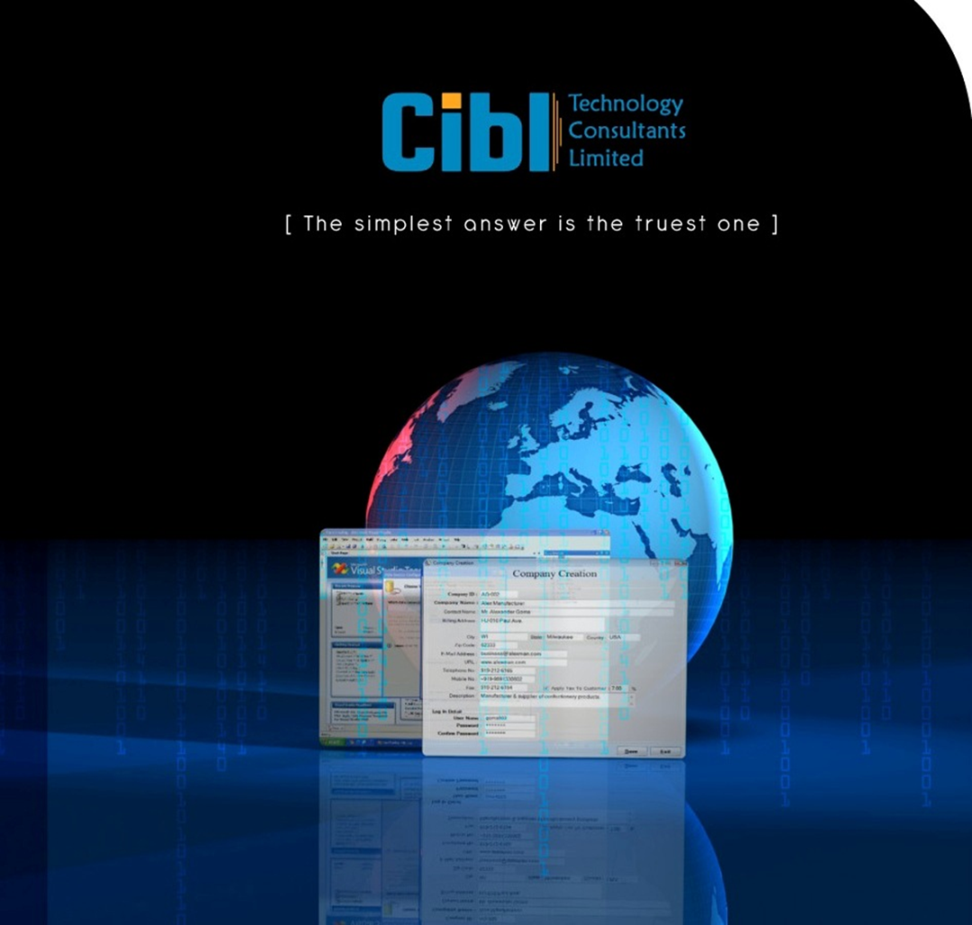

CIBL Technology Consultants Ltd.
delivering future-proof solutions …
Company Overview

Slide 2
CIBL – at a Glance
Established in May, 2008
Software Development and Systems Integration, IT Enabled Services Specialist serving reputed customers which includes commercial banks, government bodies including regulators
Software Products & Turnkey Custom Device-oriented Solution Supplier with all home grown software and hardware products
Technology Solution Consultants – Experienced leadership and solution consultancy teams
Banking, financial services, eGovernance and manufacturing domain specialists
Strong alliance with global innovation leaders
Focused on Long-term customer and partner relationship

Slide 3
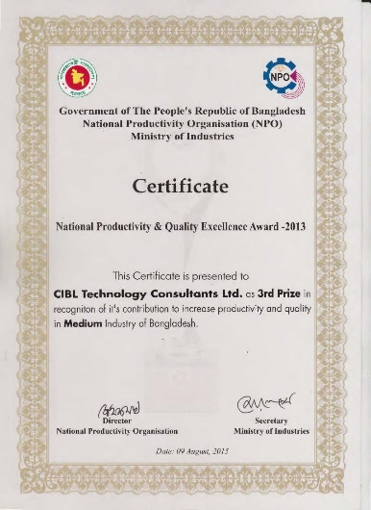
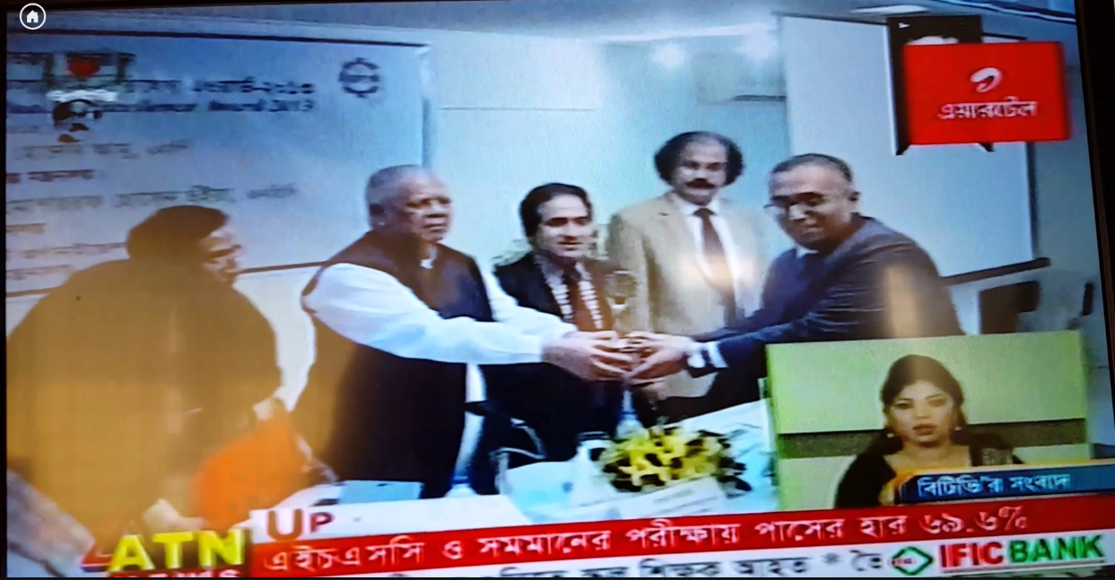
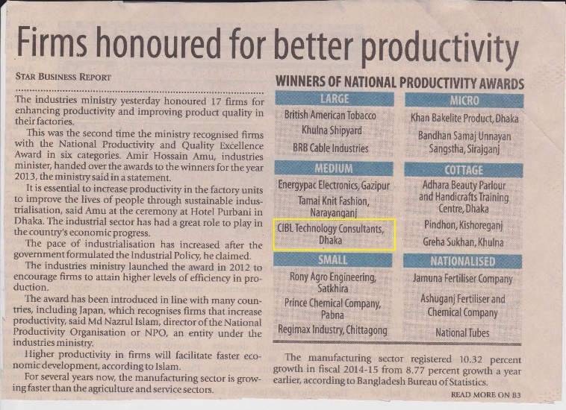
Awards and Certifications-1
Winner of “National Productivity and Quality Excellence Award” given by Ministry of Industries (MoI)
CIBL Technology Consultants Limited (CIBL), one of the fastest growing Software Development and System Integration Service Provider in Bangladesh, has been awarded with the 'National Productivity and Quality Excellence Award' by the National Productivity Organization (NPO) under the Ministry of Industries of Government of People's Republic of Bangladesh for consistent improvement in Productivity and Quality of its Products and Services as the First Software Development, Systems Integration and related IT Services Provider Company of Bangladesh.

Slide 4
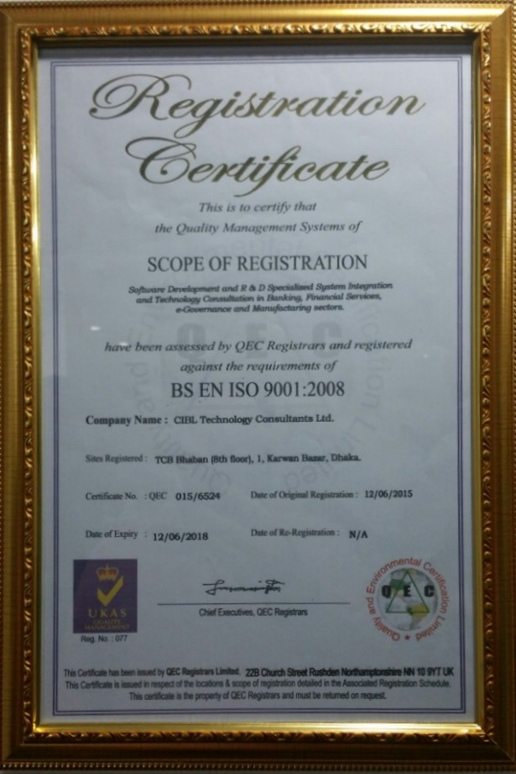
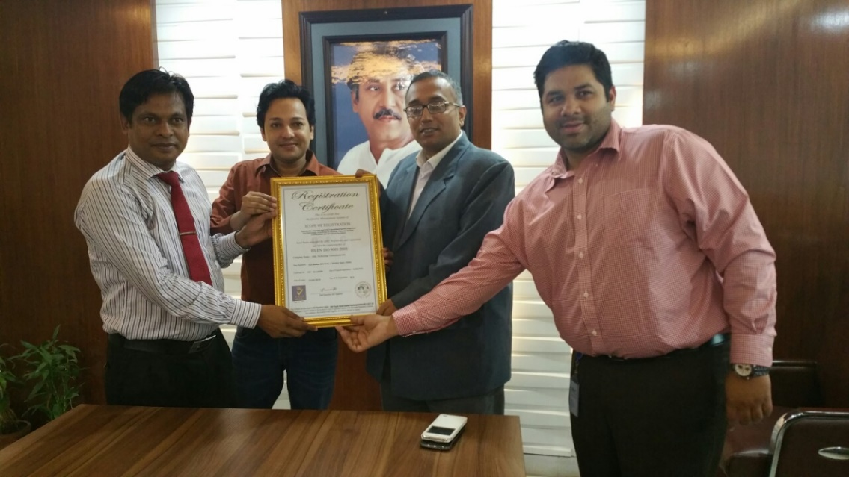
Awards and Certifications-1
As ISO 9001:2008 Quality Certified Company

Slide 5
Major Business Focus
Services Spectrum – High Level
Software
Development
& Support
Solution / System Integration
Technology Managed Services
Consultancy / Specialized Services
Custom Application
(Near and Offshore)
Banking
(Retail, Corporate, Investment, Payment Technology)
Software Ecosystem Design, Development, Integration
Program Management
Capital Market
(Exchange, Brokerage, Merchant Banking)
Infrastructure including LAN/WAN, Server, Storage, TPL etc.
Application Management
Information & Info Risk Management
Testing & Performance Engineering
Control Center, Service Desk, Help Desk, Service Lab etc.
IT Strategy Consulting & Solution Design
eGovernance
Support & Service Desk Management
Insurance & Financial Services
Field level service, activity, delivery network nation-wide
IT Process & Service Management
ERP & e-Business
(BFSI, Mfg, Retail, Hospitality)
Hosting commercial R&D Projects
Cloud Advisory Services

Slide 6
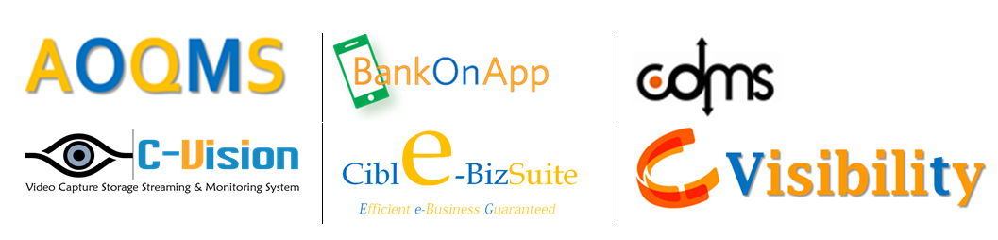


Own Products / Solutions

Slide 7





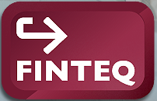



Major Global Solution Partners

Slide 8
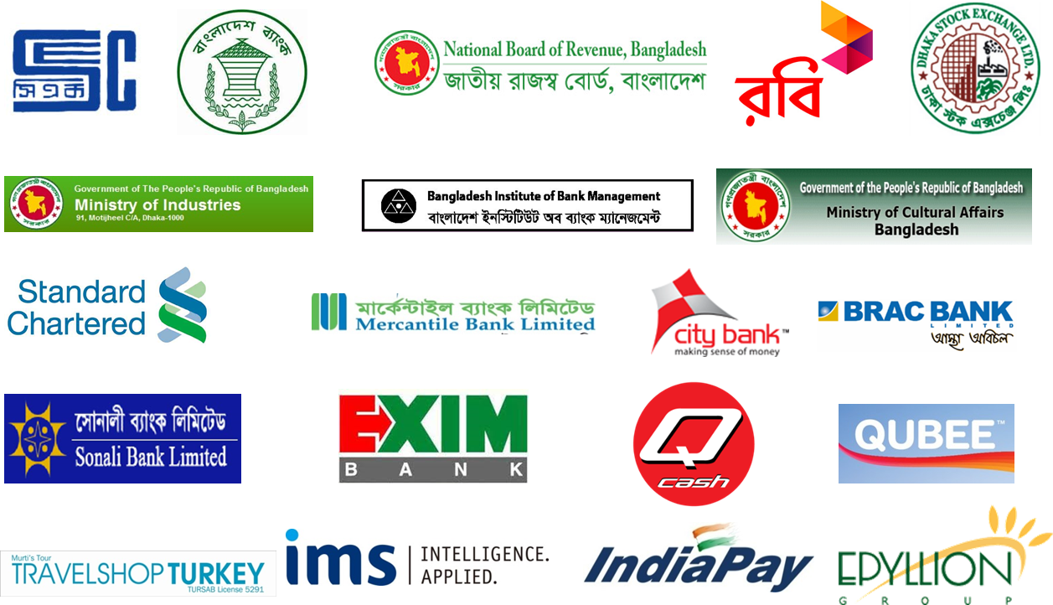






Key Customers (Both Local & International)

Slide 9
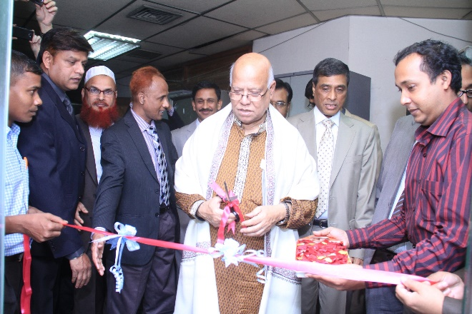
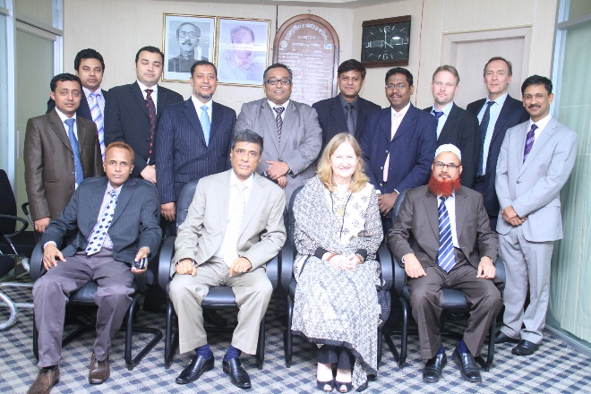


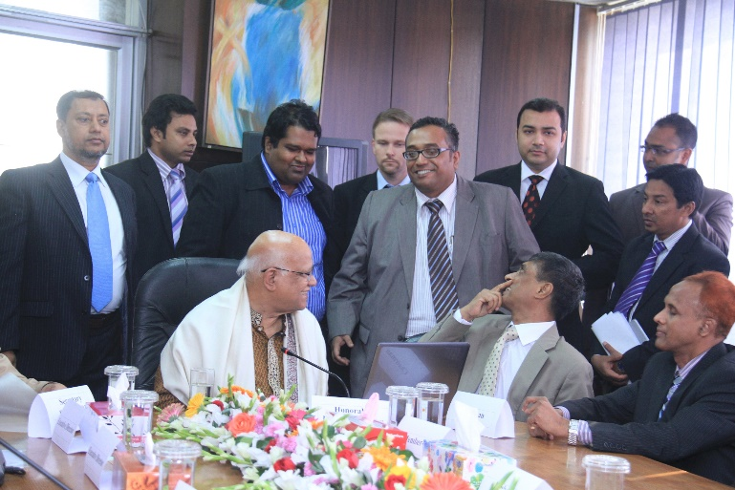
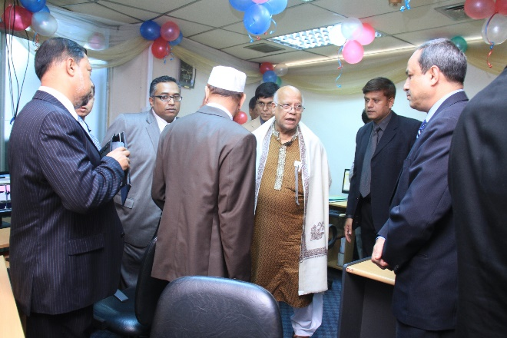
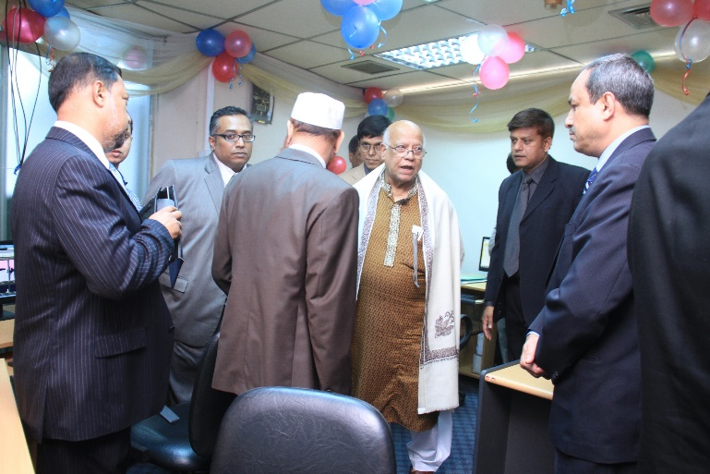
Few Significant Projects (1)
Capital Market Surveillance System (Turn-key) for Bangladesh Securities and Exchange Commission (BSEC), Ministry of Finance, Govt. of Bangladesh

Slide 10
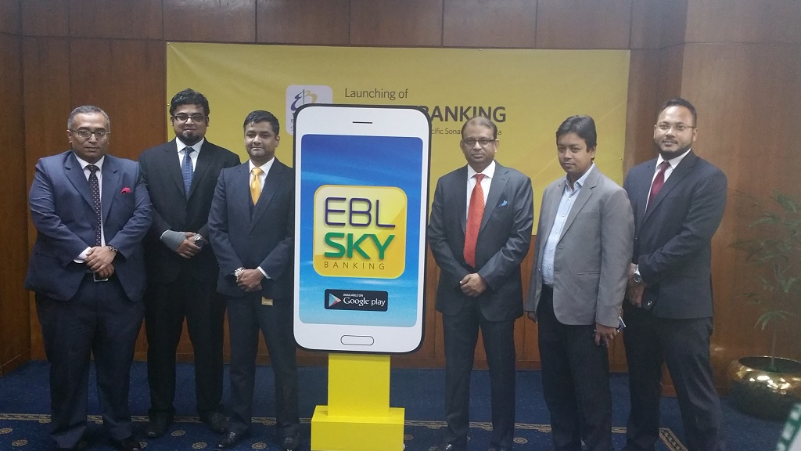
Few Significant Projects (2)
Implementation of Comprehensive Slate and Internet Banking Application for Eastern Bank Limited (EBL Sky Banking)

Slide 11
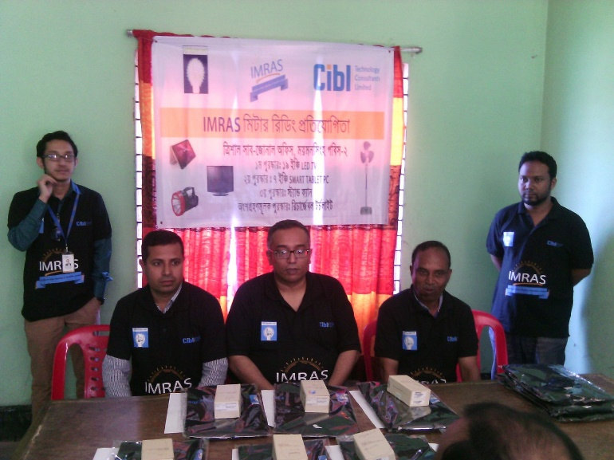
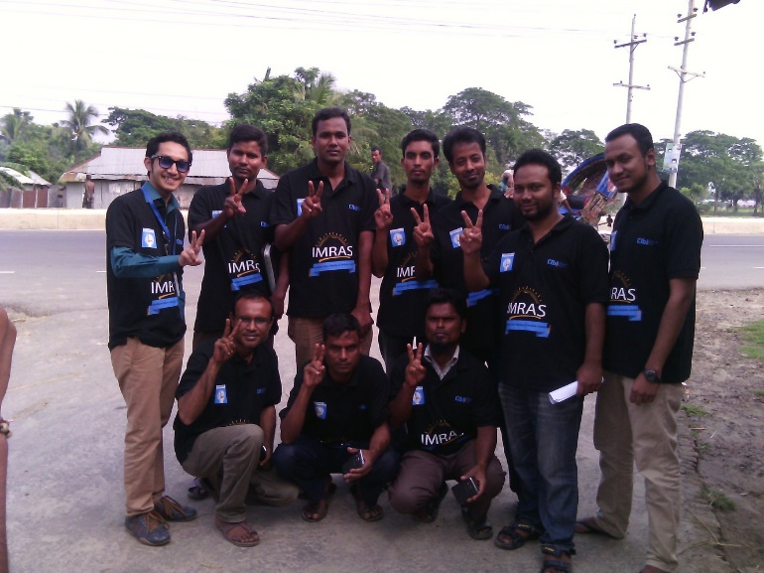
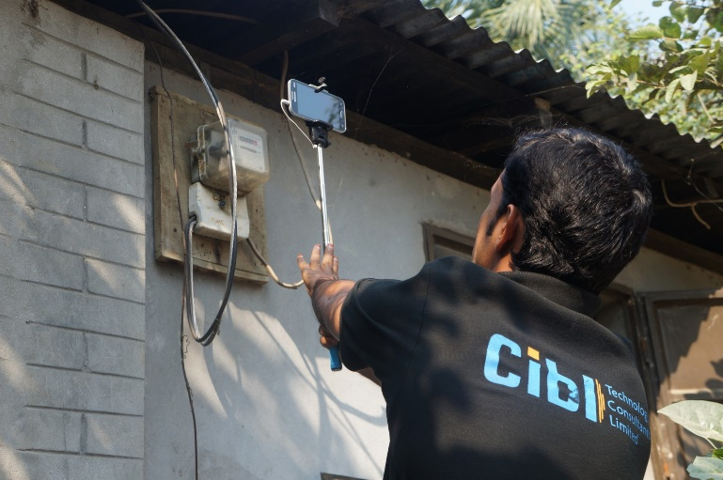
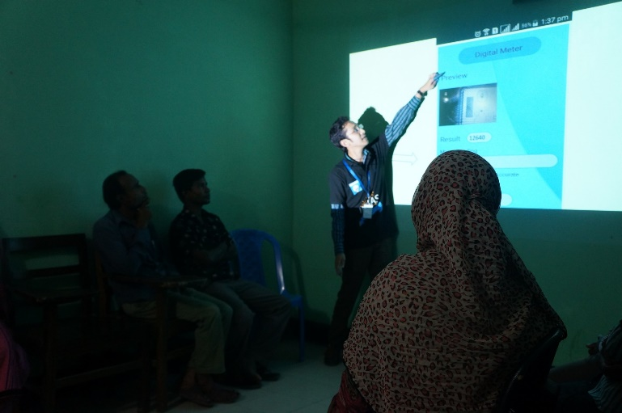
Few Significant Projects (3)
Intelligent Meter Reading & Analytic System (IMRAS) for Bangladesh Rural Electrification Board (BREB), Power Division, Ministry if Power, Energy & Mineral Resources

Slide 12
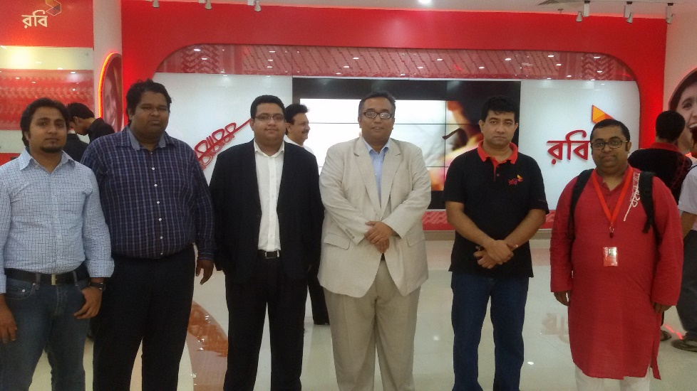
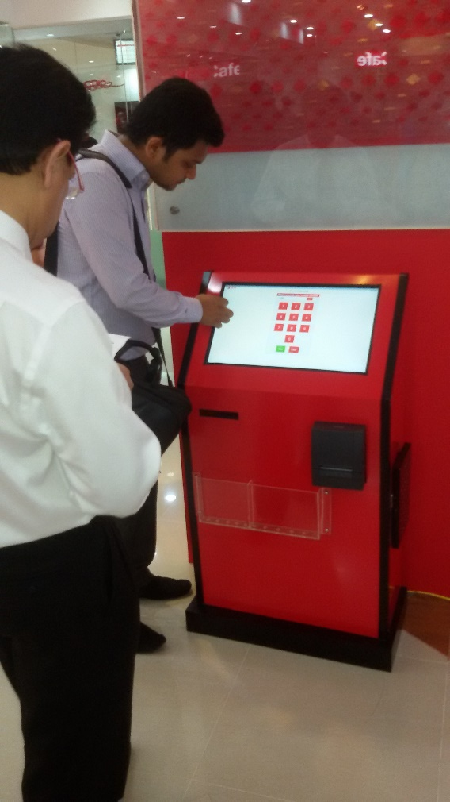
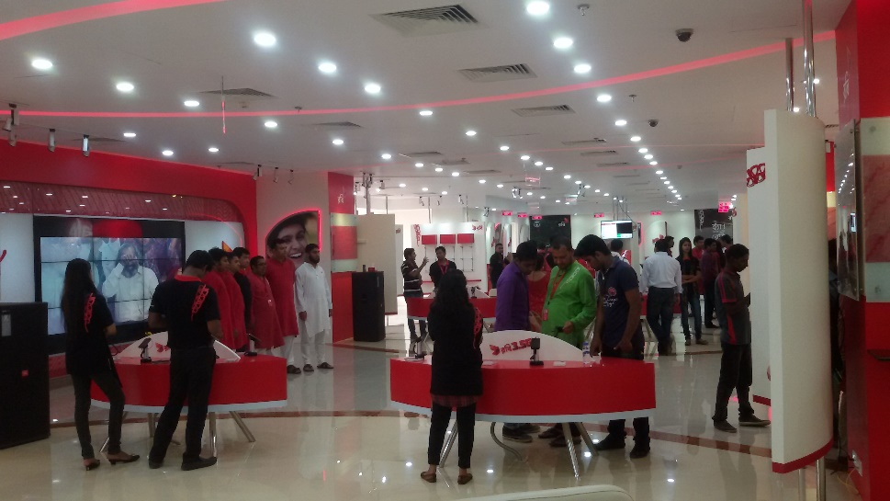
Few Significant Projects (4)
Nation-wide implementation of Customer Experience Management System & Centralized Electronic Queue Management System for Robi Axiata Ltd., Bangladesh

Slide 13
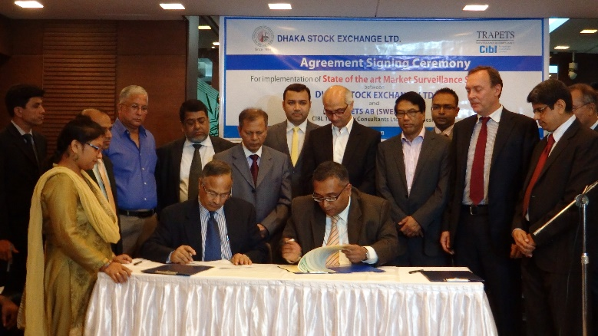
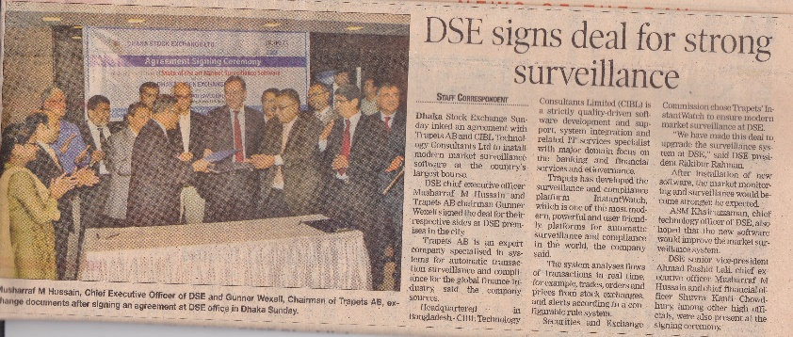
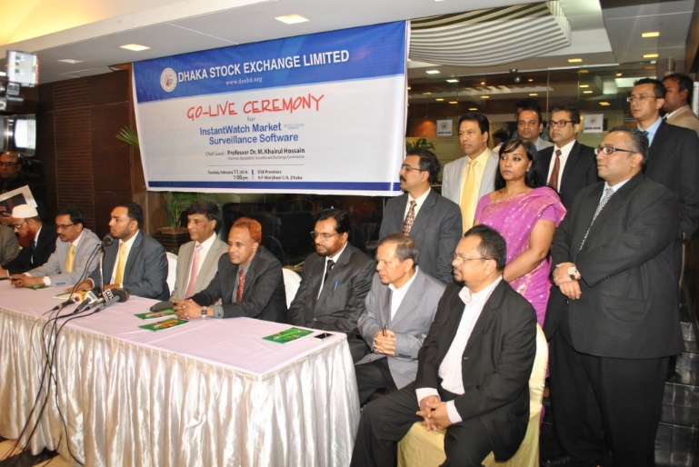

Few Significant Projects (5)
State-of-the Art Market Surveillance System (Turn-key) for Dhaka Stock Exchange Limited (DSE), Bangladesh

Slide 14
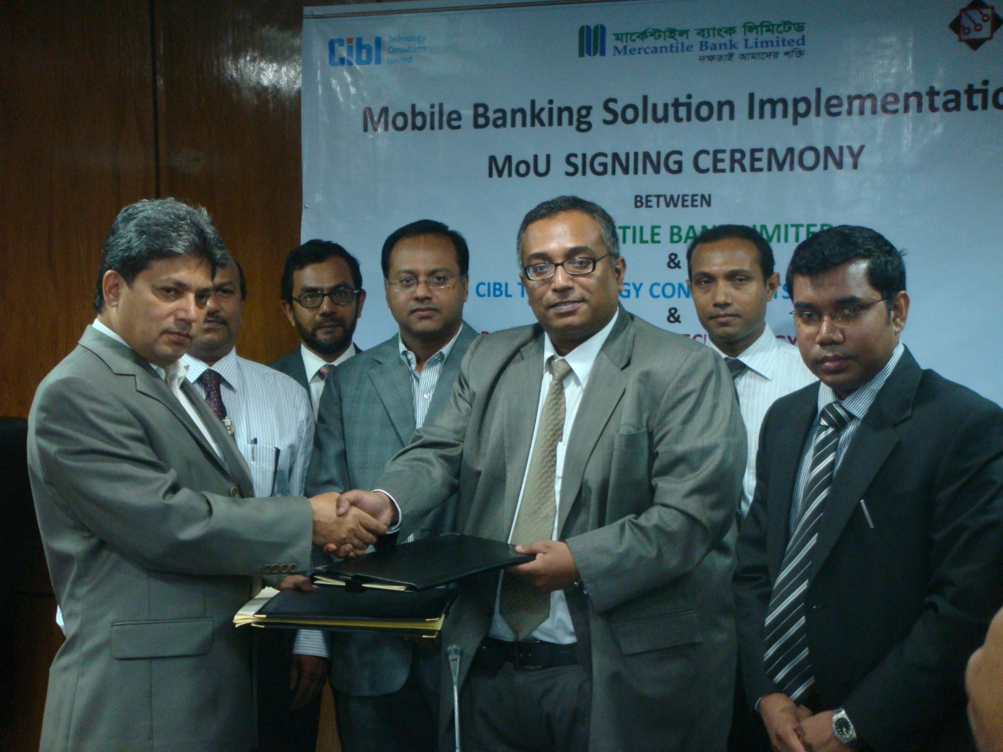
Few Significant Projects (6)
Mobile Banking System (Turn-key) for Mercantile Bank Limited, Bangladesh (MyCash / mPay)

Slide 15
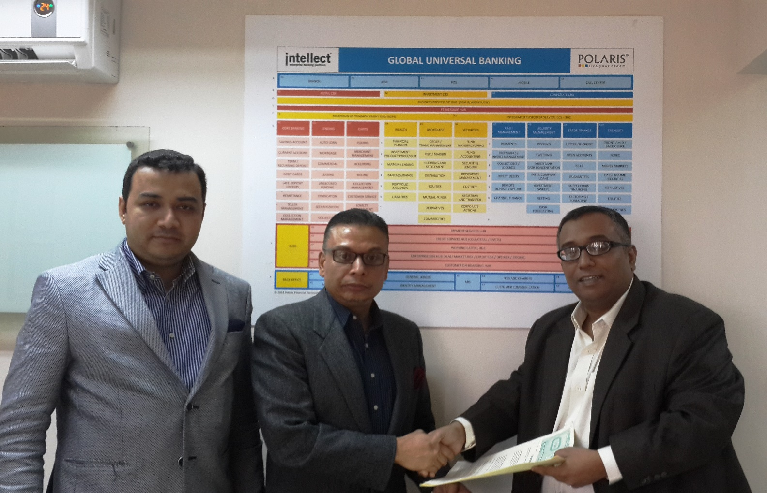
Few Significant Projects (7)
Intellect Core Banking System (CBS) Implementation for Rupali Bank Limited (Sonali Polaris FT Ltd.)

Slide 16
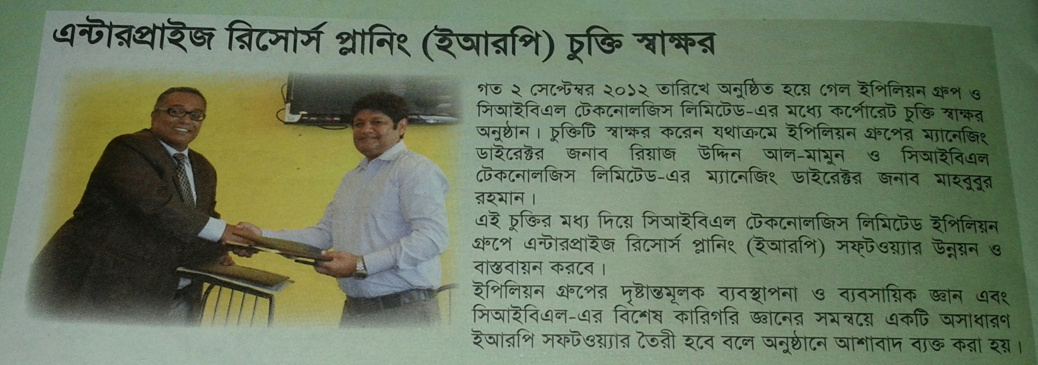
Few Significant Projects (8)
4th Generation ERP System Development for Envoy Textiles Ltd., Epyllion Group

Slide 17
Few More Significant Projects….
Centralized Electronic Queue Management System for Passport Office through the Trust Bank Limited
Online Electronic Queue Management (cityQ) & Customer Feedback Management System for The City Bank Ltd.
Modernization of Bangladesh Bank Training Academy, Inspired CELL, Ministry of Industries, Govt. of Bangladesh
Centralized Cusomter Experience Management System for Al-arafah Islami Bank Ltd., Bangladesh
Contemporary History Management System and Centralized InfoKiosk Management Systems for Ministry of Cultural Affairs, Govt. of Bangladesh

Slide 18
Organization Structure
CEO

Slide 19
Processes:
Project Implementation Lifecycle

Slide 20
Quality Management Policy
Strict compliance to ISO 9001:2008
Pillars of CIBL QMP -
  Total Customer Satisfaction
  Focus on Long-term Relationships
  Ethical Business Conduct
  Quality Measurement & Improvement
  Ensuring Quality Procurement
  Using Modern Technology
  Continuous Quality Improvement
  Quality Talent Acquisition

Slide 21
Operational Policies
CIBL Policy on Business Conduct
CIBL Admin Policy
CIBL Accounting Policy
CIBL Talent Acquisition Process

Slide 22
Office Locations
Corporate Office:
TCB Bhaban (8th Fl.), 1 Karwan Bazar, Dhaka - 1215, Bangladesh
Registered Office & Training Center:
Nakshi Homes (5th / 1st Floor), 6/1A, Segunbagicha, Dhaka - 1000, Bangladesh
Please Contact:
Tel: 88-02-8189003-4, 88-09678205596
Mob: +8801711991803, +8801847024064
E-Mail: sales.mkt@cibl-bd.com

